Slide 1

Where’s the “Work” in Working Memory?
Michael J. Kane
University of North Carolina at Greensboro

Slide 2
Outline
WM in intro texts (function)
WM measurement (dynamic)
WM x complex cognition (general)
WM x simple cognition (attention)
WM x applied decisions (attention)

Slide 3
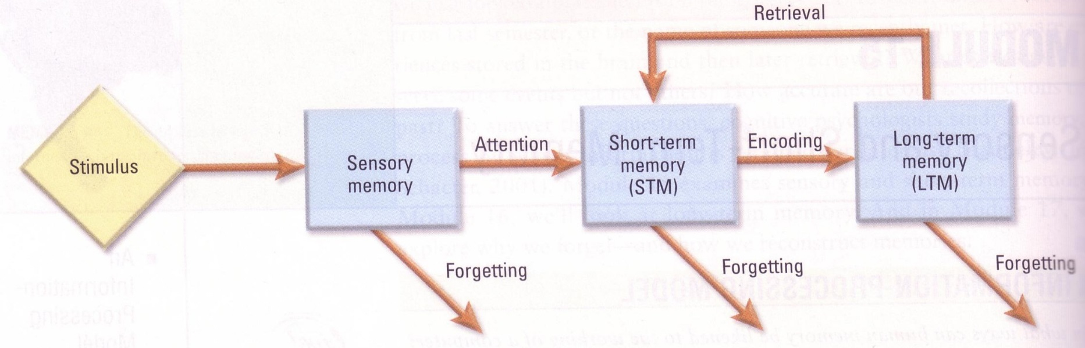
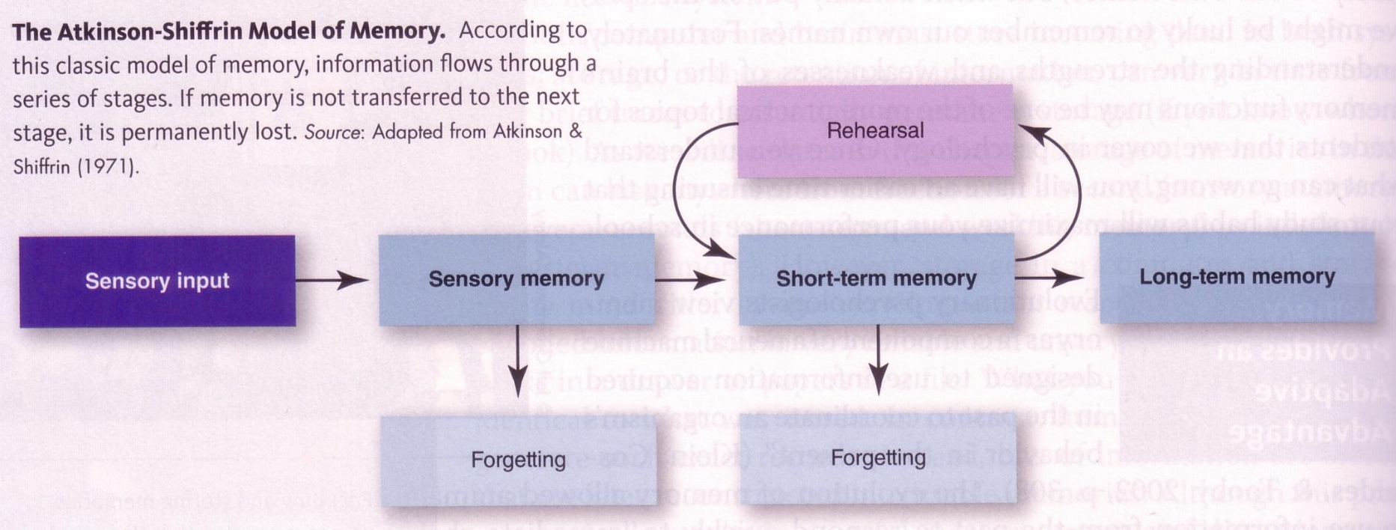
Kassin, S.M. (2006) Psychology in Modules
Caciopo, J.T., & Freberg, L.A. (2013) Discovering Psychology: The Science of Mind

Slide 4
Short-Term Memory
Small capacity
Forgetting: decay (vs. interference)
Function:
  retrieve from / transfer to LTM
  rehearse (a phone number)

Slide 5
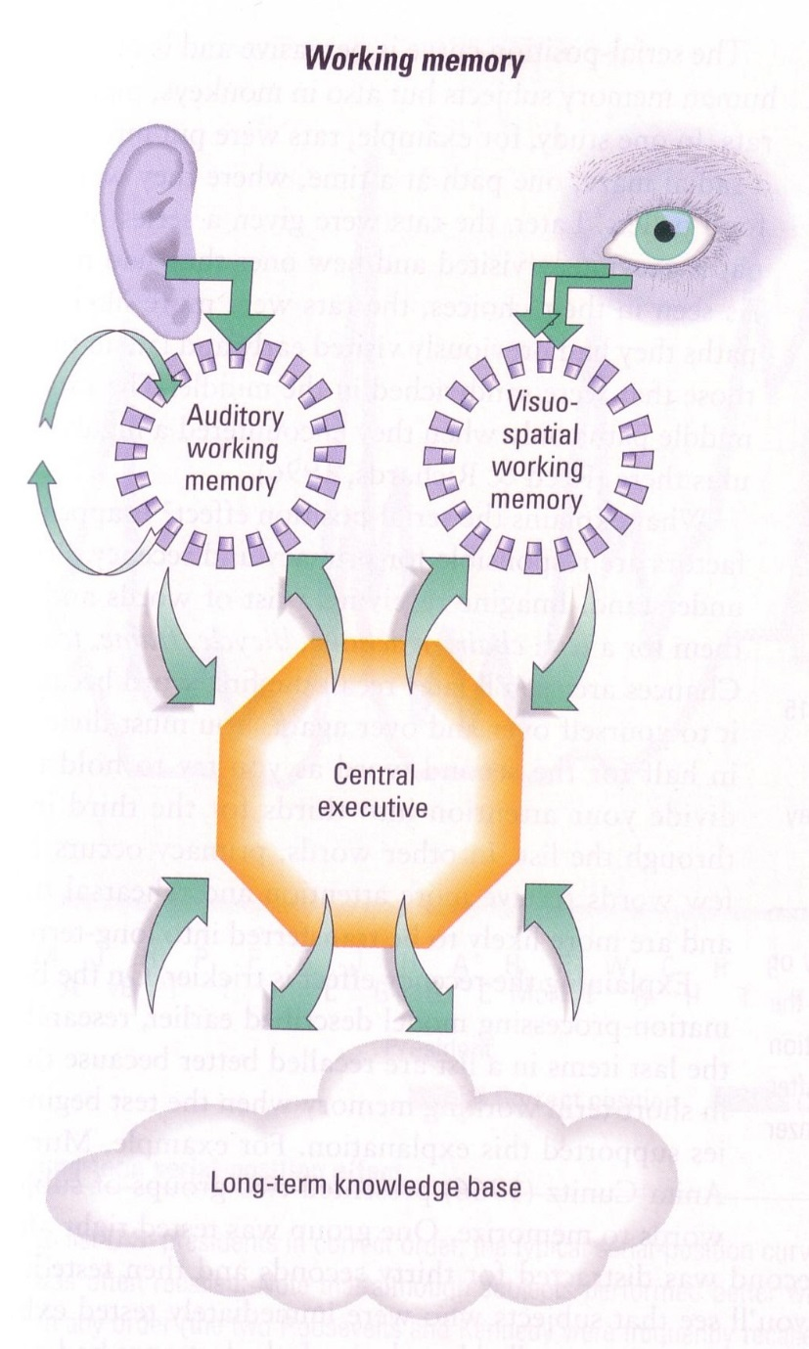
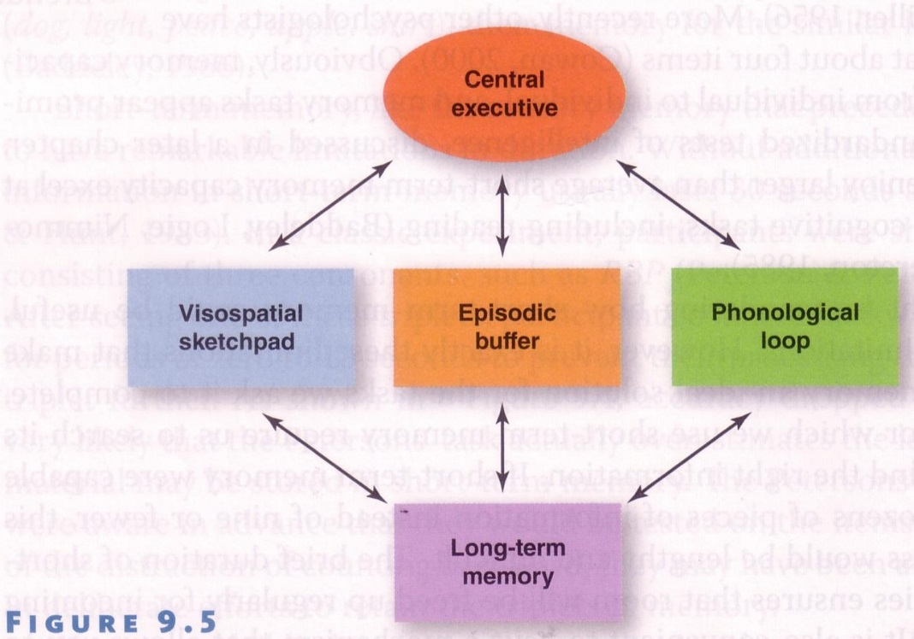
Caciopo, J.T., & Freberg, L.A. (2013) Discovering Psychology: The Science of Mind
Kassin, S.M. (2006) Psychology in Modules

Slide 6
Working Memory
Multiple (domain-specific) capacities
Forgetting: decay (vs. interference)
Function: “working”
  keep info accessible
  in service of ongoing cog / behavior

Slide 7
Working Memory
Multiple (domain-specific) capacities
Forgetting: decay (vs. interference)
Function: “working”
  keep info accessible
  in service of ongoing cog / behavior

Slide 8

Working Memory
image credit: http://www.purplewifi.net/wp-content/uploads/2014/05/history-of-wifi.png

Slide 9
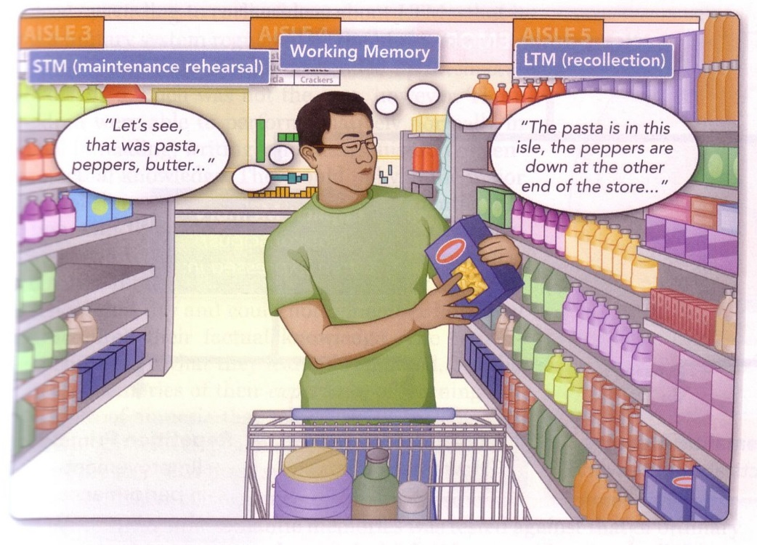
Okami, P. (2014) Psychology: Contemporary Perspectives

Slide 10
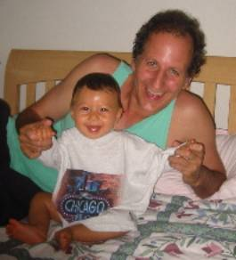
No charges, but Warschauer faces a life of grief
By Rachanee Srisavasdi
For Irvine World News, 10/9/03
The day he should have been celebrating his son’s first birthday, Mark Warschauer sat in his living room recounting how he let him die.
Warschauer had placed 10-month-old Mikey in the back seat of the dark blue family sedan the morning of Aug. 8, intending to drop him off at day care before going to work.
Instead, the UCI professor said, he drove to his office, parked his car with its windows rolled up, and walked away, leaving Mikey sleeping in his car seat.
It was 80 degrees outside. Three hours later, the infant was dead from heat stroke.

Slide 11
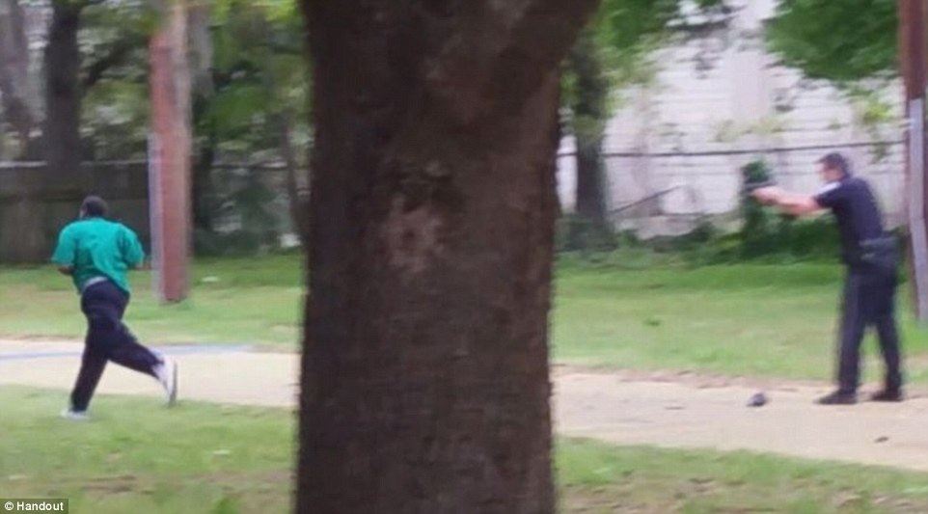
Walter Scott shooting
4/4/2015, N. Charleston, SC
Traffic stop for brake light.
Officer Michael Slager shot unarmed, 50-year-old Scott as he fled on foot (after Tasering).
Slager fired 8 rounds from behind; Scott was struck by 5.
Slager’s report claimed he had feared for his life & felt threatened.

Slide 12
Outline
WM in intro texts (function)
WM measurement (dynamic)
WM x complex cognition (general)
WM x simple cognition (attention)
WM x applied decisions (attention)

Slide 13
Measurement
STM: small capacity & rehearsal

Slide 14
Measurement
4

Slide 15
Measurement
7

Slide 16
Measurement
2

Slide 17
Measurement
8

Slide 18
Measurement
5

Slide 19
Measurement
???

Slide 20
Measurement
WM: maintenance serves ongoing

Slide 21
Measurement
Is (4 / 2) + 1 = 3 ??

Slide 22
Measurement
F

Slide 23
Measurement
Is (3 x 4) - 3 = 8 ??

Slide 24
Measurement
Q

Slide 25
Measurement
Is (8 / 2) + 2 = 6 ??

Slide 26
Measurement
H

Slide 27
Measurement
Is (5 x 2) - 6 = 3 ??

Slide 28
Measurement
R

Slide 29
Measurement
???

Slide 30
Measurement

Slide 31
Measurement
6

Slide 32
Measurement
3

Slide 33
Measurement
8

Slide 34
Measurement
5

Slide 35
Measurement

Slide 36
Measurement
+2

Slide 37
Measurement
-3

Slide 38
Measurement
-1

Slide 39
Measurement
-4

Slide 40
Measurement
???

Slide 41
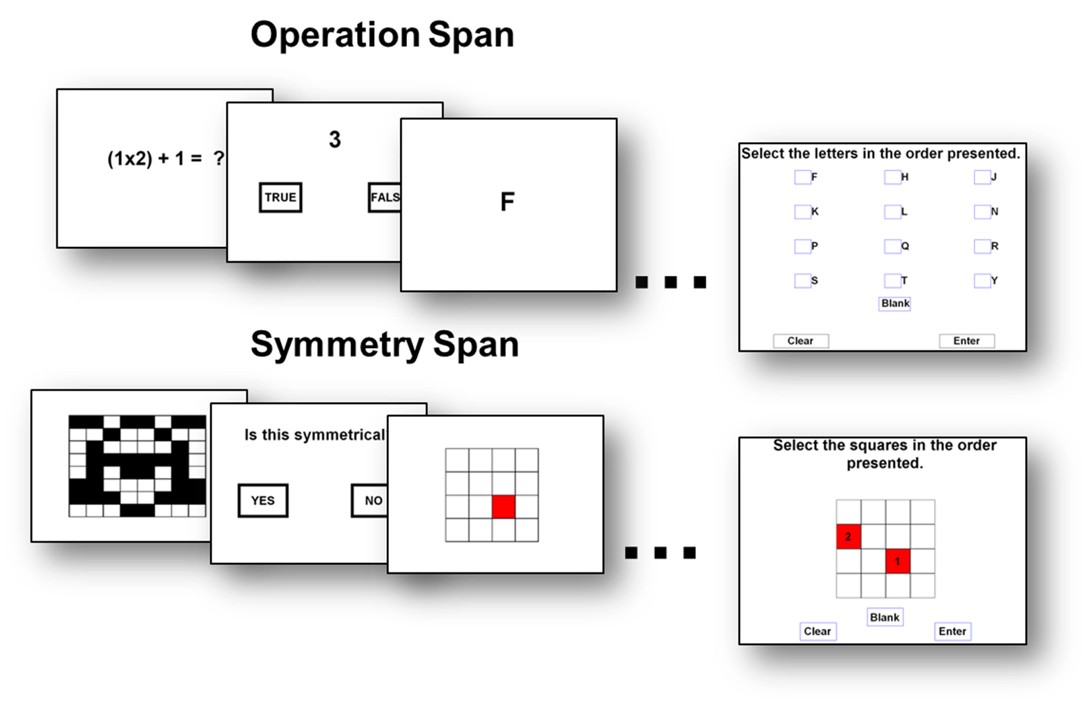
Operation Span
Symmetry Span
Harrison, T L. et al., (2013). Psychological Science, 24, 2409-2419.

Slide 42
Measurement
Function: individual differences

Slide 43
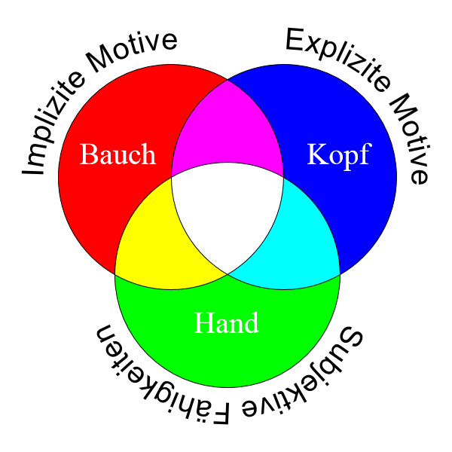
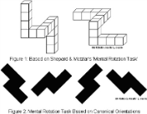
Measurement
(7+5) / 3 = ?
See Jack run.
operspan
WMC
readspan
WMC
rotaspan
Latent Variables
Adapted from source: Wikimedia Commons

Slide 44
Outline
WM in intro texts (function)
WM measurement (dynamic)
WM x complex cognition (general)
WM x simple cognition (attention)
WM x applied decisions (attention)

Slide 45
WM × Complex Cognition
Reading & speech comprehension
Learning: spelling, vocab, programming
Note-taking
Essay writing
SAT scores
Important and General

Slide 46
WM × Complex Cognition
How general ?
Predicts VSAT & MSAT
  operation vs. reading span

Slide 47
WM × Complex Cognition
How general ?
Predicts VSAT & MSAT
  operation vs. reading span
Predicts non-verbal intelligence (Gf)

Slide 48
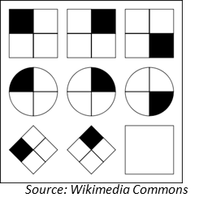
WM × Complex Cognition
Engle et al. (1999, JEPG)

Slide 49
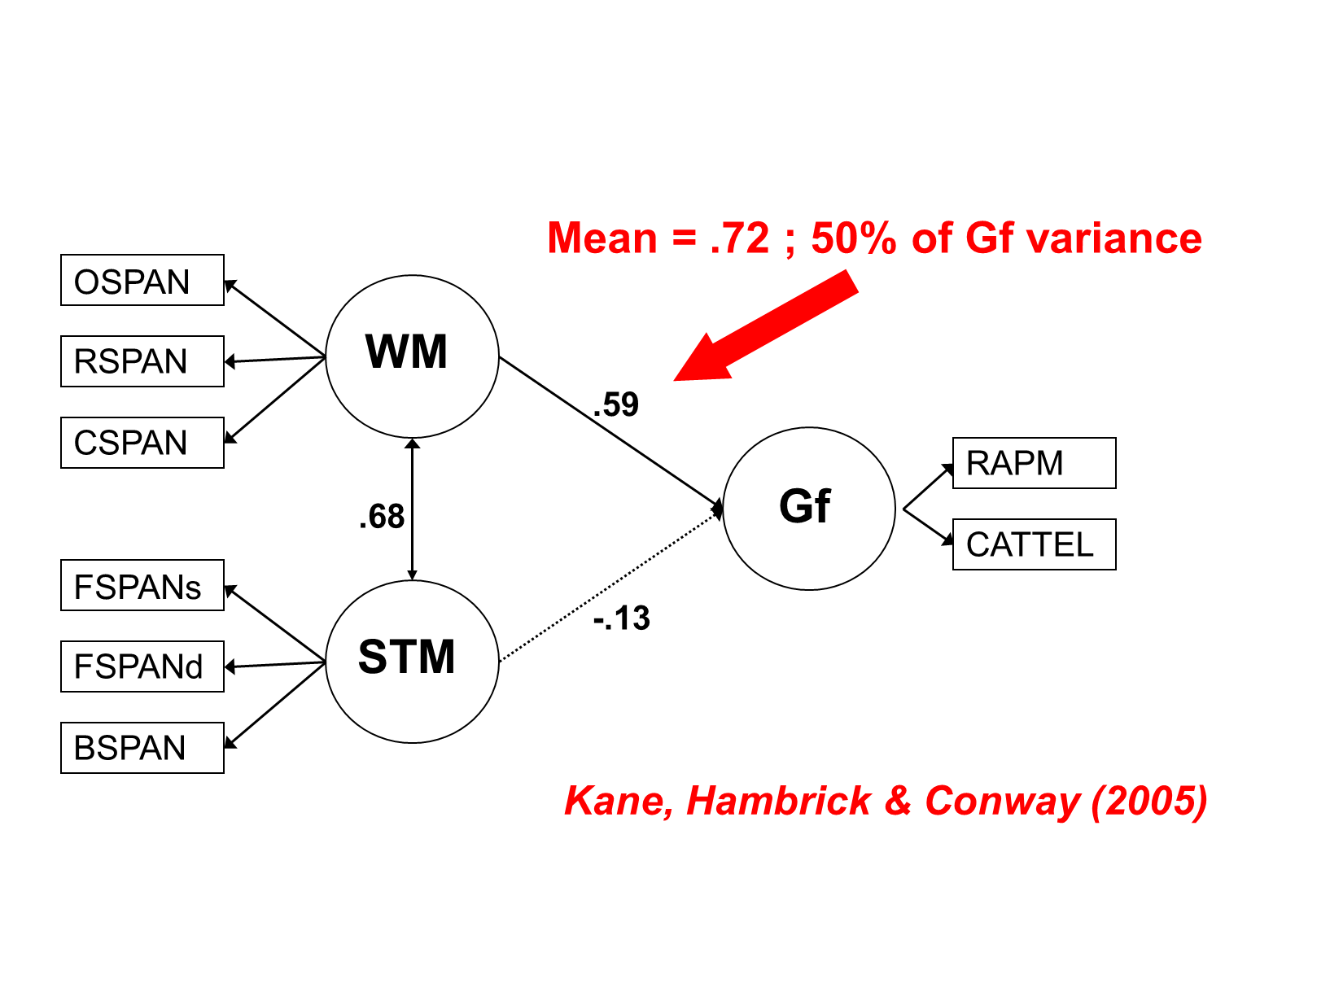
WM × Complex Cognition
Engle et al. (1999, JEPG)

Slide 50
WM × Complex Cognition
Engle et al. (1999, JEPG)

Slide 51
WM × Complex Cognition
Engle et al. (1999, JEPG)

Slide 52
WM × Complex Cognition
How general ?
Predicts VSAT & MSAT
  operation vs. reading span
Predicts non-verbal intelligence (Gf)
Verbal vs. visuospatial WM (& STM)

Slide 53
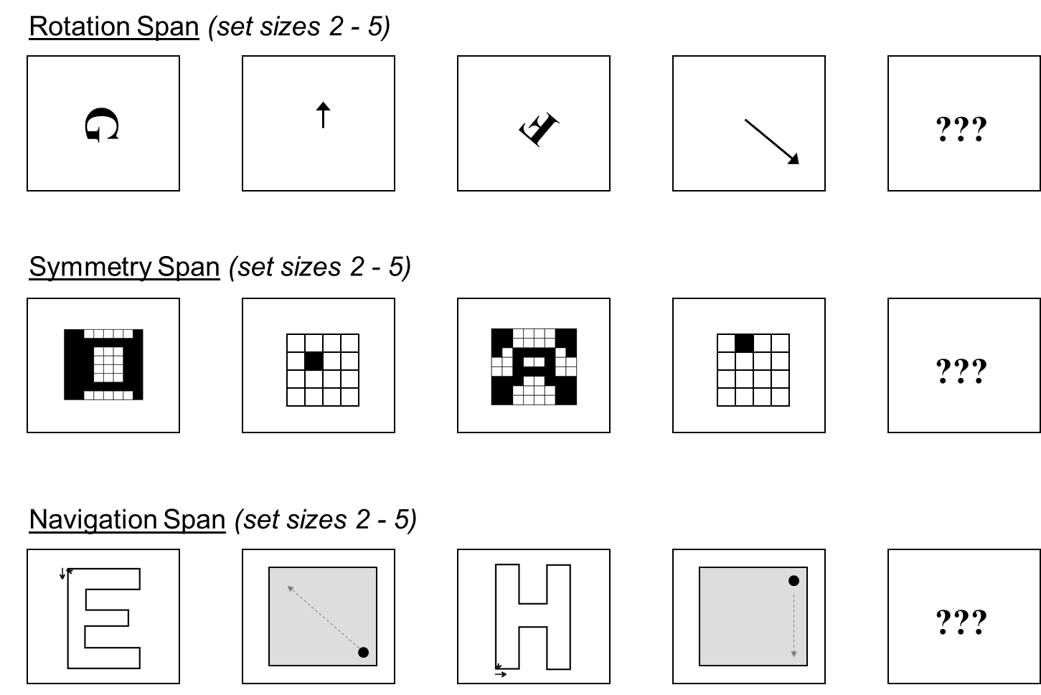
WM × Complex Cognition
Kane et al. (2004, JEPG)

Slide 54
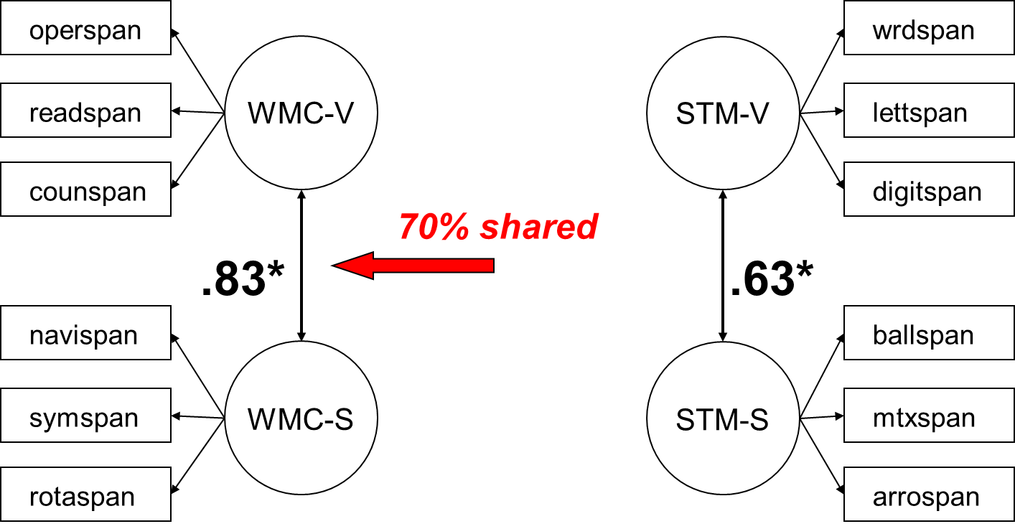
WM × Complex Cognition
Kane et al. (2004, JEPG)

Slide 55
WM × Complex Cognition
Kane et al. (2004, JEPG)

Slide 56
WM × Complex Cognition
Kane et al. (2004, JEPG)

Slide 57
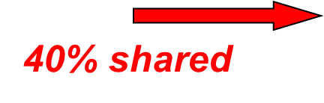
WM × Complex Cognition
Kane et al. (2004, JEPG)

Slide 58
WM × Complex Cognition
How general ?
Predicts VSAT & MSAT
  operation vs. reading span
Predicts non-verbal intelligence (Gf)
Verbal vs. visuospatial WM (& STM)
Child Prodigies

Slide 59
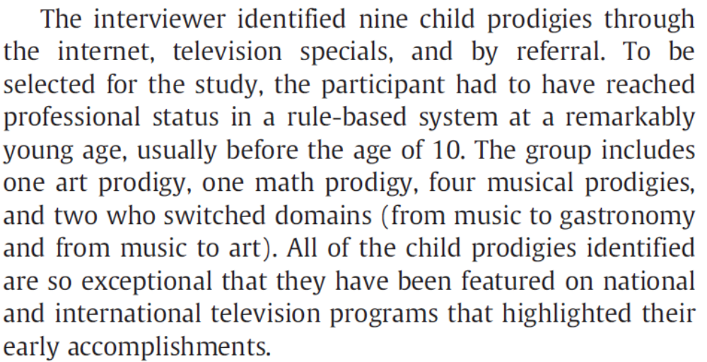
WM × Complex Cognition
Ruthsatz & Urbach (2012, Intelligence)

Slide 60
WM × Complex Cognition
Ruthsatz & Urbach (2012, Intelligence)
Prodigy | SB Full IQ | SB Gf | SB WM
1 Music / Gastro | 96 %ile | 92 %ile
2 Music / Vis Art | -- | 91 %ile
3 Music | 90 %ile | 66 %ile
4 Music | 97 %ile | 99 %ile
5 Music | 92 %ile | 92 %ile
6 Music | 70 %ile | 58 %ile
7 Vis Art | 79 %ile | 50 %ile
8 Mathematics | 98 %ile | 88 %ile
MEAN | 88.9 %ile | 79.5 %ile

Slide 61
WM × Complex Cognition
Ruthsatz & Urbach (2012, Intelligence)
Prodigy | SB Full IQ | SB Gf | SB WM
1 Music / Gastro | 96 %ile | 92 %ile | 99.9 %ile
2 Music / Vis Art | -- | 91 %ile | 99.9 %ile
3 Music | 90 %ile | 66 %ile | 99.7 %ile
4 Music | 97 %ile | 99 %ile | 99.9 %ile
5 Music | 92 %ile | 92 %ile | 99.9 %ile
6 Music | 70 %ile | 58 %ile | 99.9 %ile
7 Vis Art | 79 %ile | 50 %ile | 99.0 %ile
8 Mathematics | 98 %ile | 88 %ile | 99.9 %ile
MEAN | 88.9 %ile | 79.5 %ile | 99.8 %ile

Slide 62
WM × Complex Cognition
How general ?
Predicts VSAT & MSAT
  operation vs. reading span
Predicts non-verbal intelligence (Gf)
Verbal vs. visuospatial WM (& STM)
Child prodigies
QUITE

Slide 63
WM × Complex Cognition
Why ?
Not memory storage
What’s unique to WM (vs. STM) ?

Slide 64
WM × Complex Cognition
Why ?
Not memory storage
What’s unique to WM (vs. STM) ?
Attention? WM span = dual task!
  maintaining info in face of:
    interference from prior lists
    distraction / shifts of conscious focus

Slide 65
Outline
WM in intro texts (function)
WM measurement (dynamic)
WM x complex cognition (general)
WM x simple cognition (attention)
WM x applied decisions (attention)

Slide 66
WM × Simple Cognition
WM diffs in attention tasks
Maintaining novel goals
Resolving distraction / conflict

Slide 67
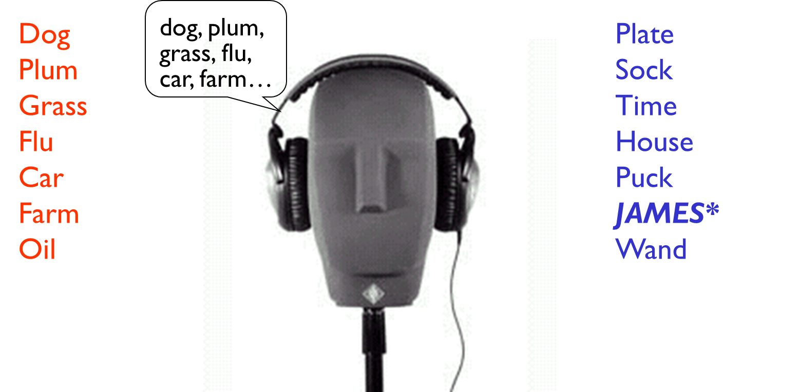
WM × Simple Cognition
Conway, Cowan, & Bunting (2001, PB&R)

Slide 68
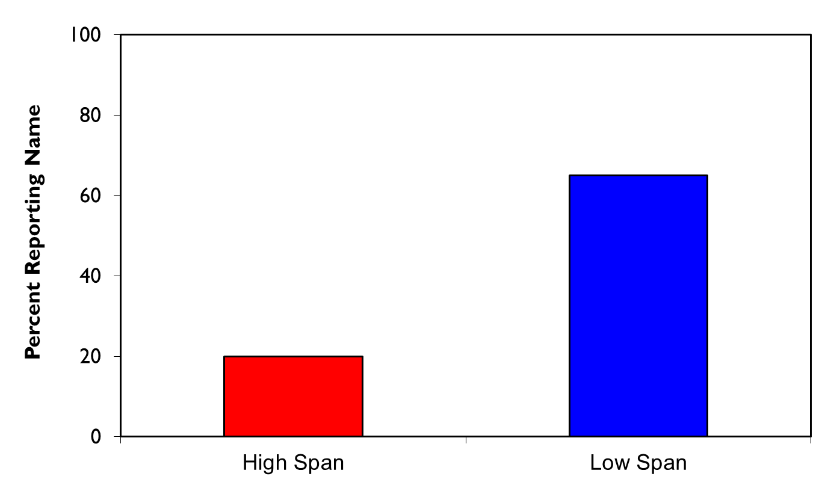
WM × Simple Cognition
Conway, Cowan, & Bunting (2001, PB&R)
65%
20%
High WMC
Low WMC

Slide 69
WM × Simple Cognition
Conway, Cowan, & Bunting (2001, PB&R)
65%
20%
High WMC
Low WMC

Slide 70
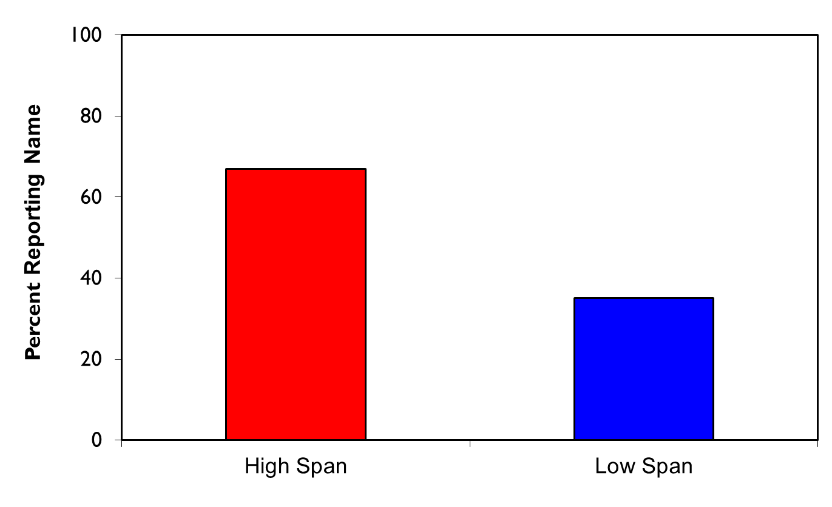
WM × Simple Cognition
Colflesh & Conway (2007, PB&R)
67%
35%
High WMC
Low WMC

Slide 71
WM × Simple Cognition
Colflesh & Conway (2007, PB&R)
67%
35%
High WMC
Low WMC

Slide 72
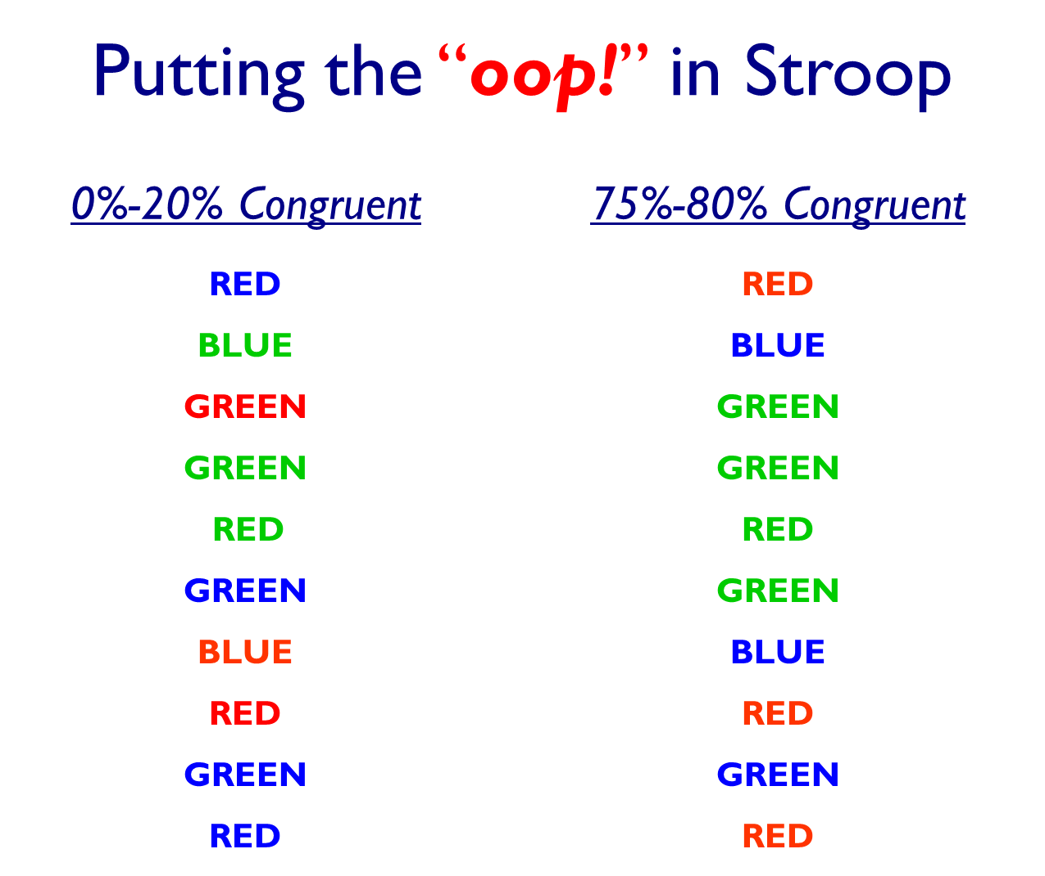
WM × Simple Cognition
Kane & Engle (2003, JEPG)

Slide 73
WM × Simple Cognition
Kane & Engle (2003, JEPG)

Slide 74
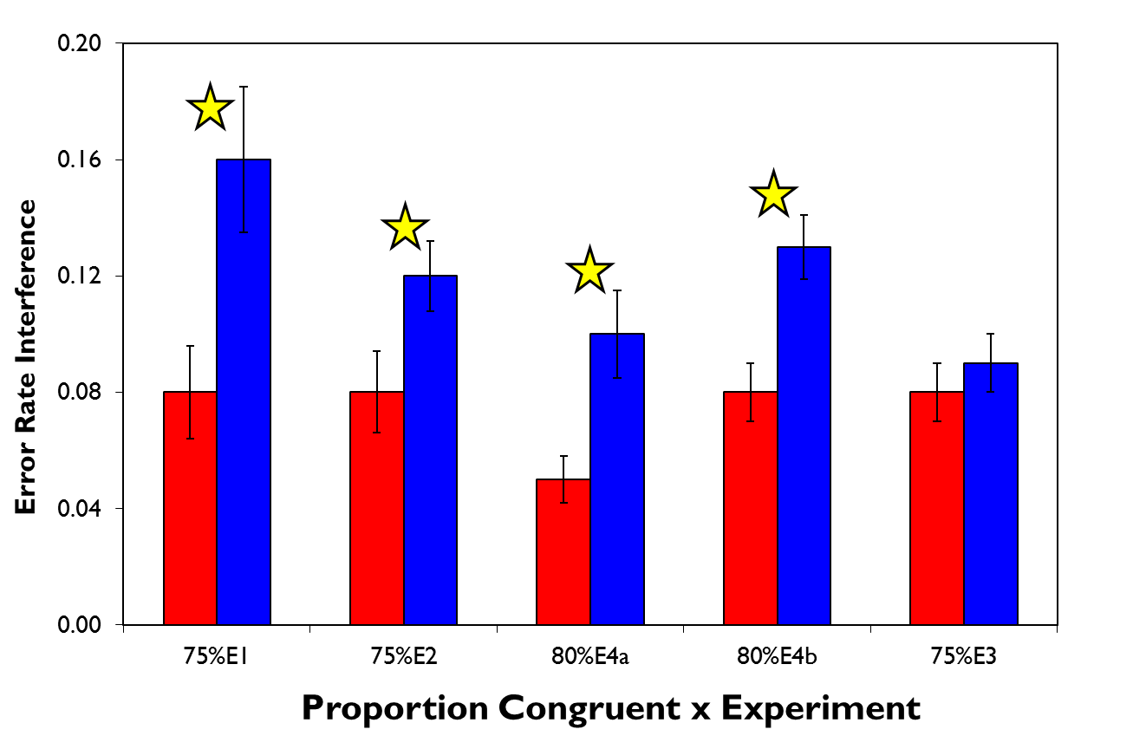
WM × Simple Cognition
Kane & Engle (2003, JEPG)
Hi WM
Lo WM

Slide 75
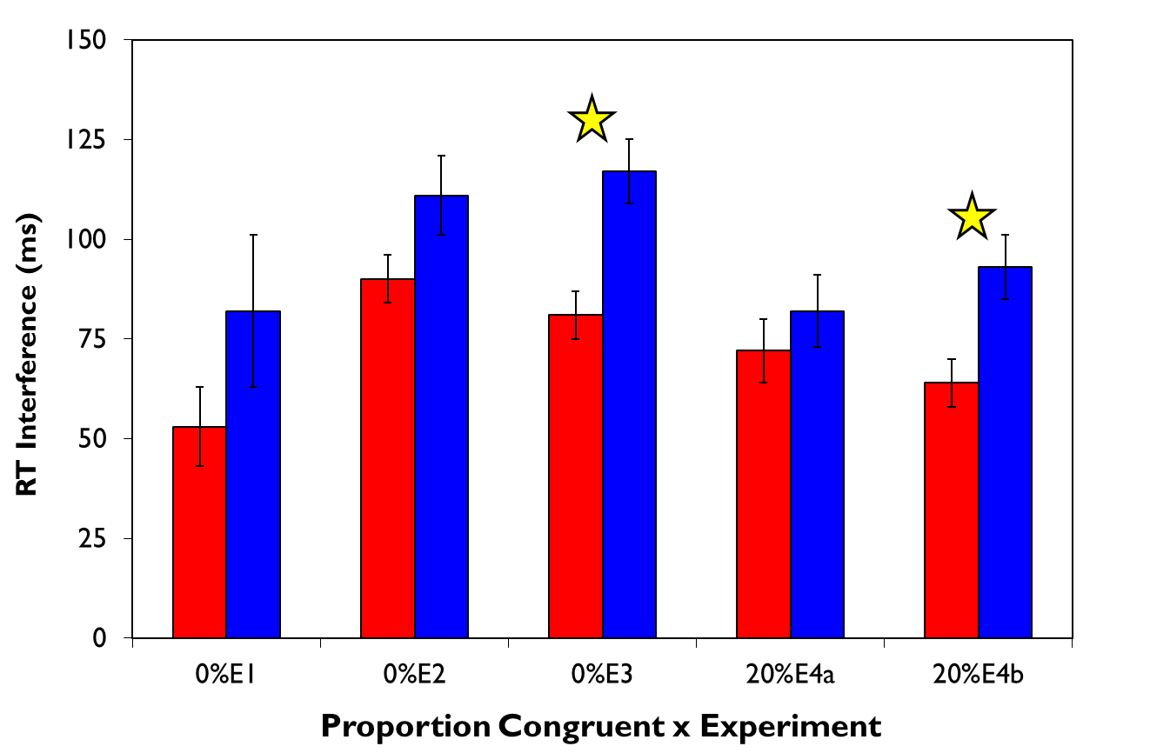
WM × Simple Cognition
Kane & Engle (2003, JEPG)
Hi WM
Lo WM

Slide 76
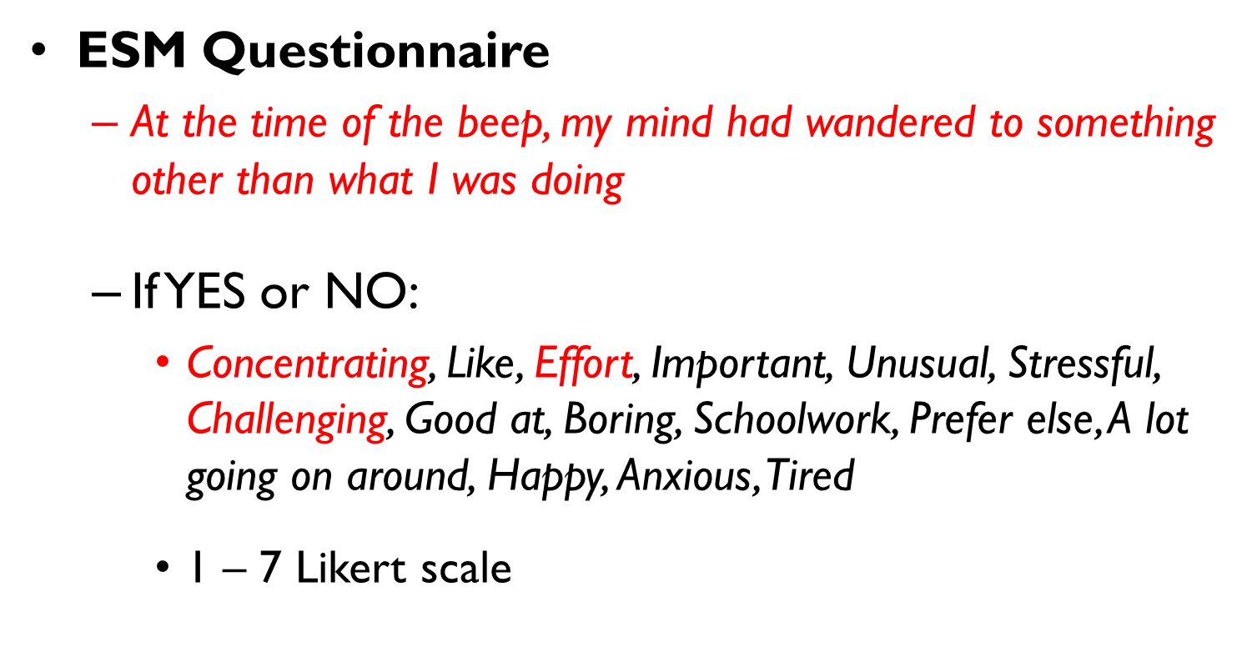
WM × “Feral” Cognition
Kane et al. (2007, Psych Science)

Slide 77
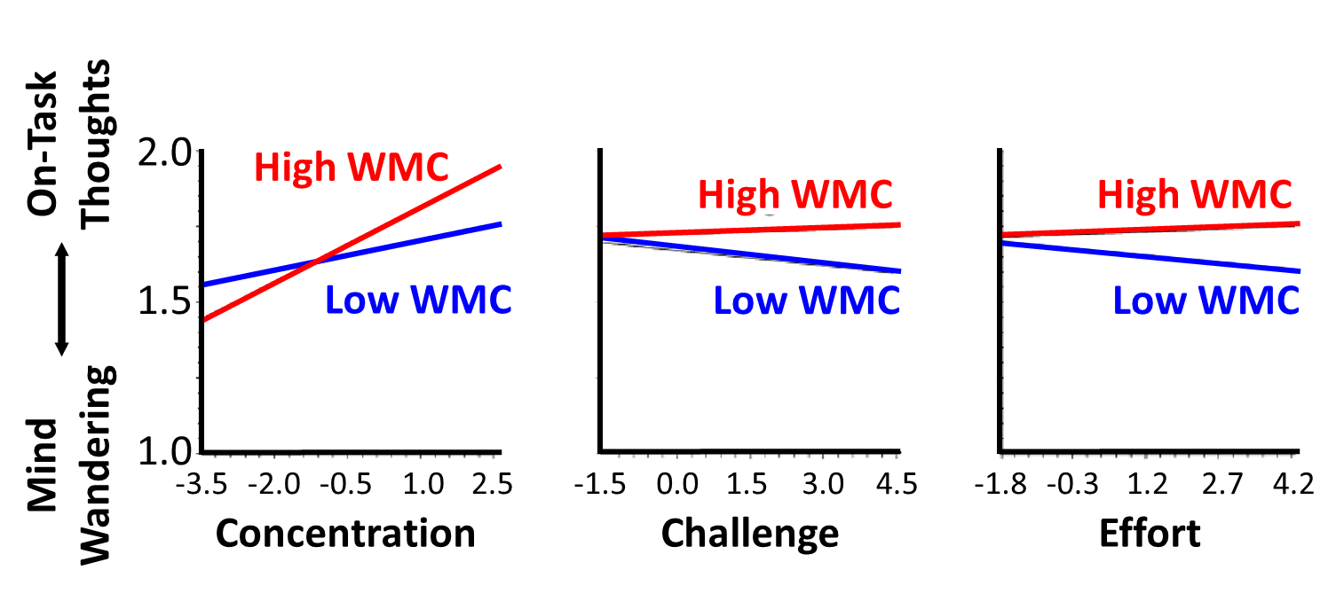
WM × “Feral” Cognition
Kane et al. (2007, Psych Science)

Slide 78
WM × Simple Cognition
Kane et al. (under review)
WM
ATTN
17 latent variable studies

Slide 79
WM × Simple Cognition
Kane et al. (under review)
r ≈ .60
WM
ATTN
17 latent variable studies

Slide 80
WM × Simple Cognition
WM diffs in attention tasks
Maintaining novel goals
Resolving distraction / conflict

Slide 81
Outline
WM in intro texts (function)
WM measurement (dynamic)
WM x complex cognition (general)
WM x simple cognition (attention)
WM x applied decisions (attention)

Slide 82
WM × Applied Decisions
WM diffs in attention control
Maintaining novel goals
Resolving distraction / conflict

Slide 83
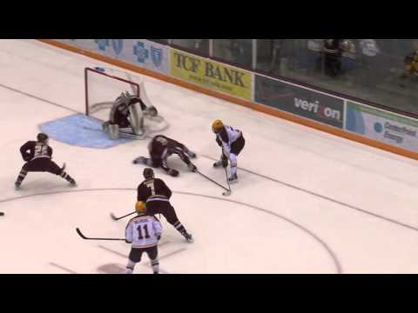
WM × Applied Decisions
Furley & Memmert (2012, J Sport Ex Psy)
- pro & semi-pro Ss
- speeded decisions
- 30% time-out trials
- 66% valid advice

Slide 84
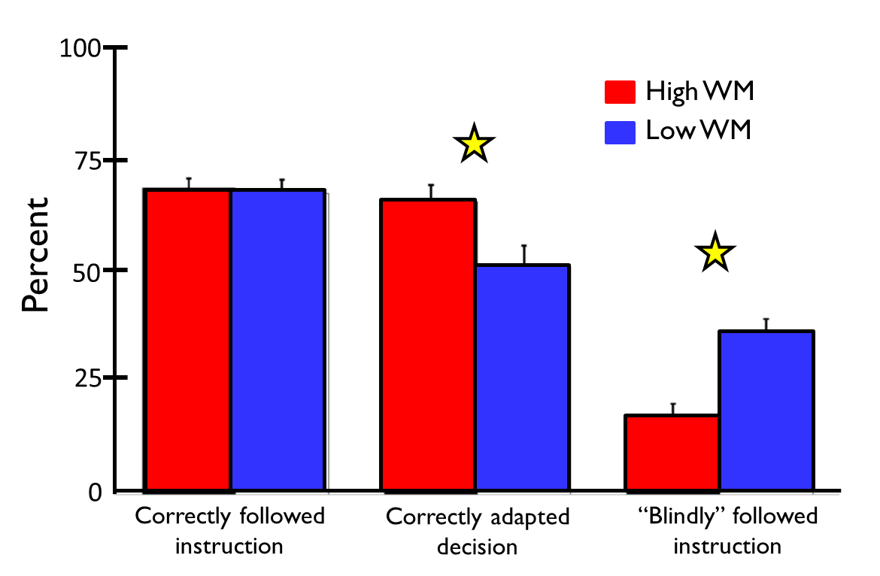
WM × Applied Decisions
Furley & Memmert (2012, J Sport Ex Psy)

Slide 85
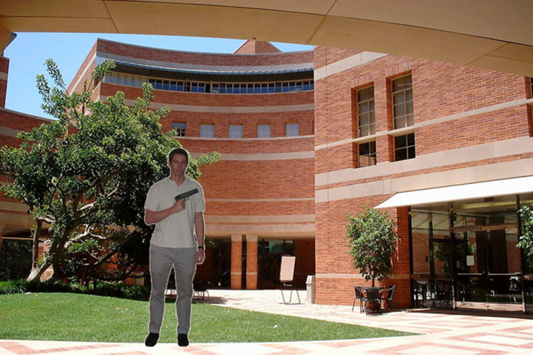
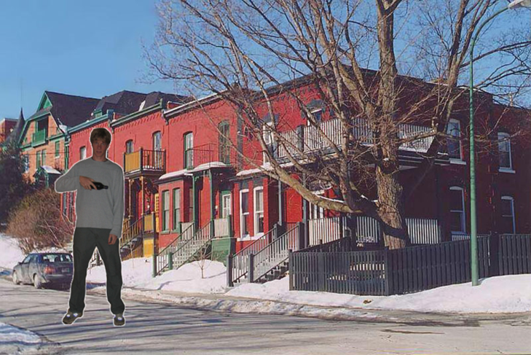
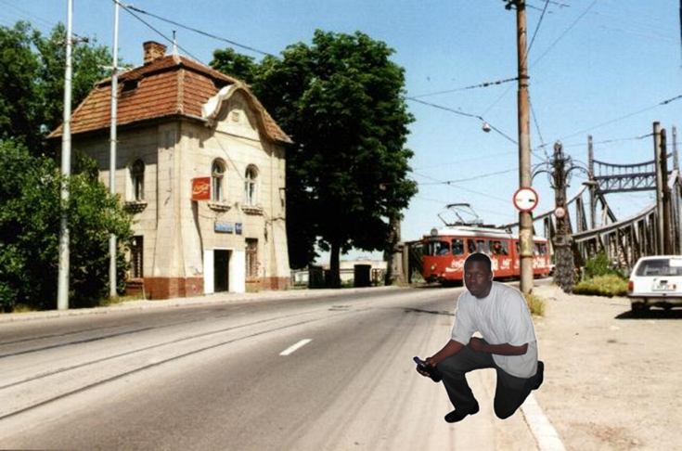
WM × Applied Decisions
Kleider et al. (2010, Applied Cog Psy)
- ATL cops
- speeded decisions
- 1st watch video
- ECG + face EMG

Slide 86
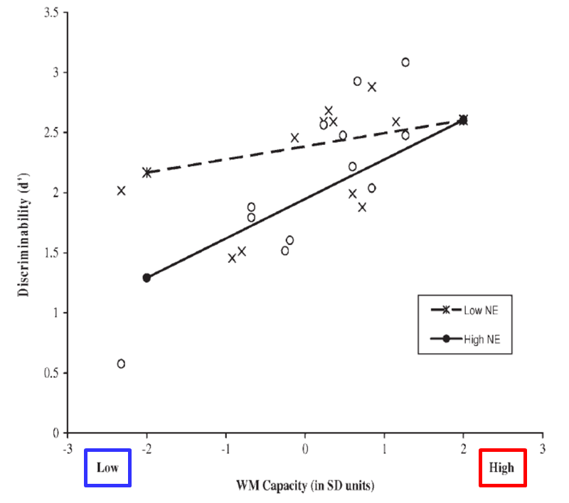
WM × Applied Decisions
Kleider et al. (2010, Applied Cog Psy)
Discriminability (d')
X
Lo Neg Emotion
0
Hi Neg Emotion
low
high
WM (sd units)

Slide 87
WM × Applied Decisions
WM diffs in attention control
Maintaining novel goals
Resolving distraction / conflict
WM as cause
WM as effect

Slide 88
Walter Scott shooting
4/4/2015, N. Charleston, SC
Traffic stop for brake light.
Officer Michael Slager shot unarmed, 50-year-old Scott as he fled on foot (after being Tasered).
Slager fired 8 rounds from behind; Scott was struck by 5.
Slager’s report claimed he had feared for his life & felt threatened.
WM x emotion
WM as cause
WM as effect

Slide 89
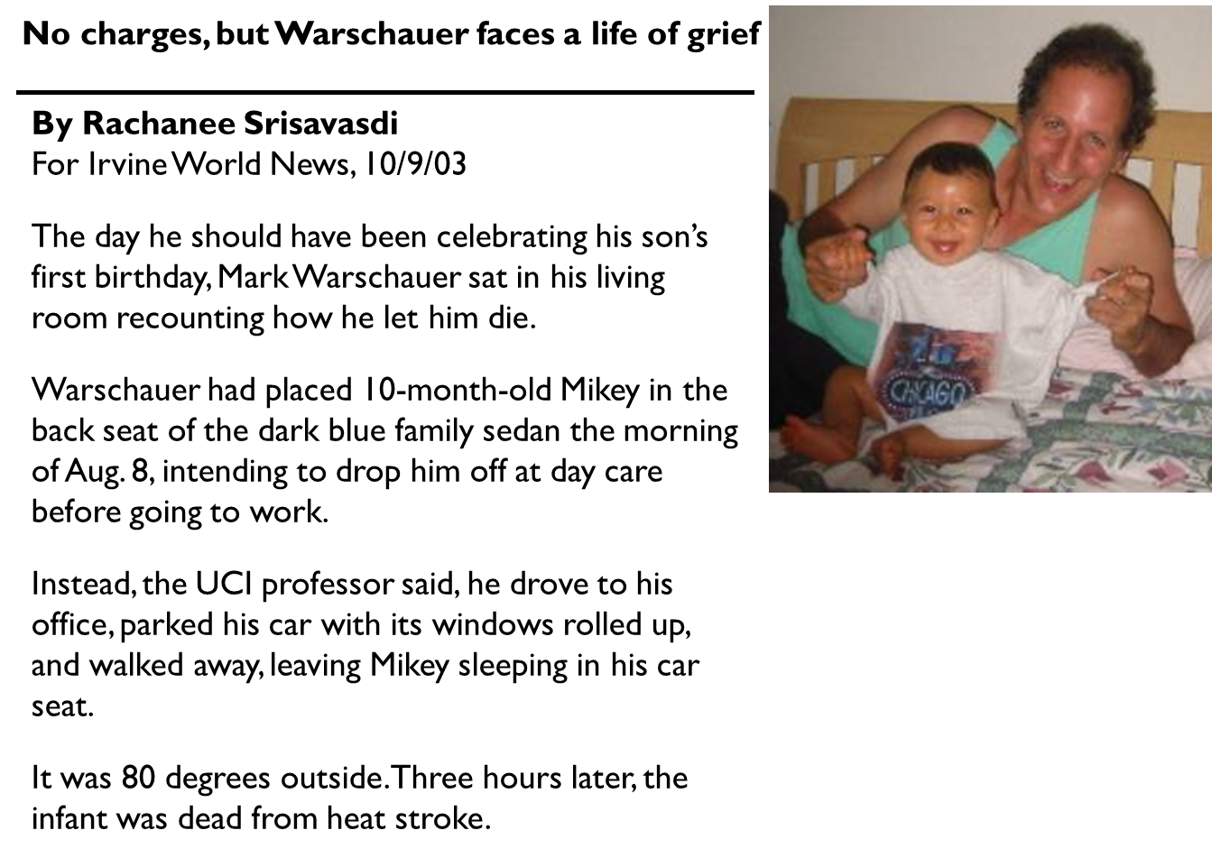
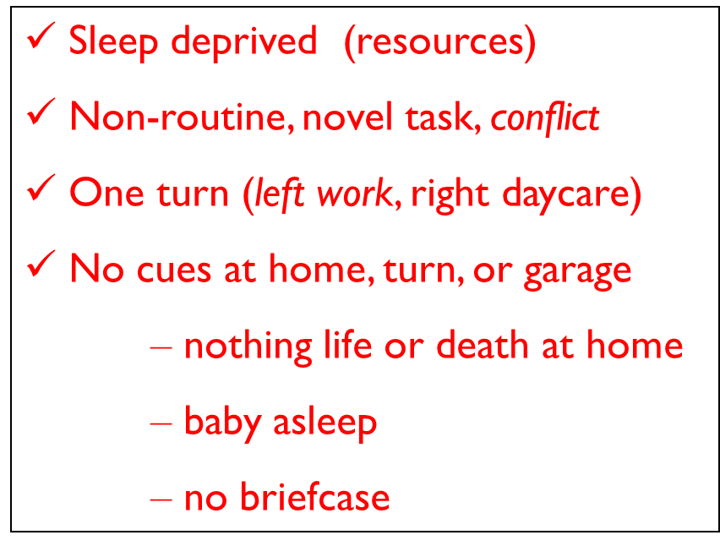

Slide 90
Outline
WM in intro texts (function)
WM measurement (dynamic)
WM x complex cognition (general)
WM x simple cognition (attention)
WM x applied decisions (attention)

Slide 91

mjkane@uncg.edu
@kane_WMC_lab
http://www.uncg.edu/~mjkane/presentations.html

